Slide 1



18ECP105J-MINOR PROJECT-III FIRST REVIEW
DEPARTMENT OF ELECTRONICS AND COMMUNICATIONENGINEERING
SMART IRRIGATION
PRESENTED BY:
PAVIPRAVEENA .G - 927621BEC142
POOJA SHREE M - 927621BEC146
SASIREKHA .T - 927621BEC189
GUIDE BY:
MR.L.RAMESH

Slide 2
INTRODUCTION
In India, agriculture plays an important role for development in food production. In our country, agriculture are depends on the monsoons which is not sufficient source of water
In Irrigation system, depending upon the soil type, water is provided to plant.
In this project,the Microcontroller transmits that information on the internet through a network of IoT in the form of wifi module ESP8266 that is attached to it.
This enhances automated irrigation as the water pump can be switched on or off through information given to the controller.

Slide 3
ABSTRACT
Smart Irrigation System is develop to create an automated irrigation mechanism which turns the pumping motor ON and OFF on detecting the moisture content of the earth using the soil moisture sensor without the intervention of human.
The benefit of employing these techniques is to decrease human interference and it is quite feasible and affordable.
This Smart irrigation system project is using an arduino micro-controller, that is programmed to collect the input signal according to moisture content of the soil and its output is given to the op-amp that will operate the pump.

Slide 4
OBJECTIVES
Farmer are struggling hard in the agriculture field and the task of irrigating field is becoming quite difficult for the farmers
Sometimes they switch on the motor and then forget to switch off which may leads to wastage of water.
Similarly, they even forget to switch ON the irrigation system, which again leads to damage to the crops.
So the main objective of this project is to overcome this problem.
we have implemented a technique by using Arduino microcontroller and IoT

Slide 5
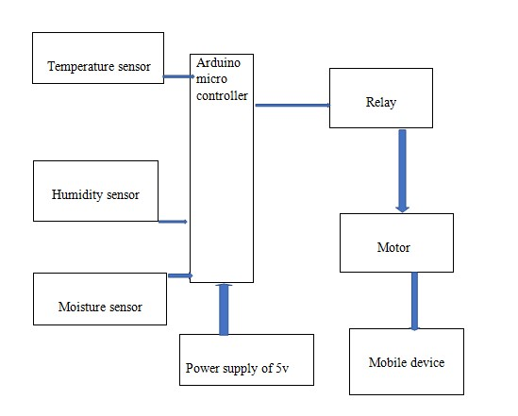
BLOCK DIAGRAM

Slide 6
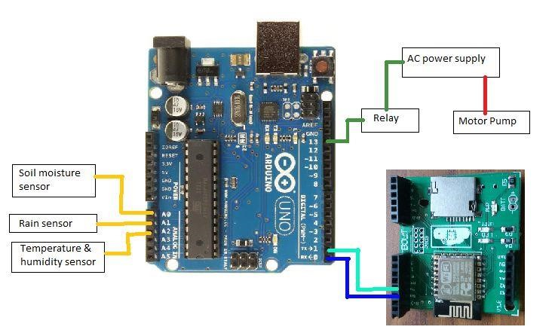
CIRCUIT DIAGRAM

Slide 7
PROBLEM STATEMENT
In the case of traditional irrigation system water saving is not considered. The absence of automatic controlling of the system result in improper water control system.
At present there is emerging global water crisis where managing scarcity of water has become a serious job.
So we want to design an Smart Irrigation System using arduino and Iot that operate automatically by sensing the moisture content of the soil and turn ON/OFF the pump using relay without the intervention of farmer and hence save water.

Slide 8
EXISTING METHOD
Existing smart irrigation systems typically consist of a combination of sensors, controllers, and automation technologies.
Soil moisture sensors are deployed in the ground to measure moisture levels, while weather-based controllers utilize real-time weather data to adjust watering schedules.
These systems may also integrate flow sensors to detect leaks or abnormal water flow, rain sensors to prevent irrigation during rainfall

Slide 9
PROPOSED METHOD
In the proposed irrigation system,the ESP8266 Wi-Fi Module is used in this IoT based irrigation system for transmitting the real time data of the field for irrigation process to the user through the IoT network.
Here soil moisture sensor measures the water content of soil and its output is fed to the amplifier.And this measured value is given to the Arduino uno
The output from Arduino and wifi module is given to driver circuit and server respectively. Based on the information given to the driver circuit the pump gets on when it is required.

Slide 10
COMPARISON OF EXISTING METHOD AND PROPOSED METHOD
In the proposed system instead of normal irrigation type only with sensors,IoT is used with arduino microcontroller.
By arranging some useful sensors like temperature, humidity, soil moisture sensors will find the percent of moisture in soil.
Then if the moisture percent is low, then motor will gets ON atomically and OFF when it maintains a sufficient percent and notification SMS is send to the user through IoT.

Slide 11
MODULES IDENTIFIED
Moisture sensor
DC pump
Relay unit
Esp8266 node MCU
Solinoid valve
7805 regulator
Power supply
Arduino Nano

Slide 12
CONCLUSION
The Project ‘Smart Irrigation System’ is used for the optimization use of water in agricultural field without the intervention of farmer by using soil moisture sensor.
Sensor senses the moisture content of the Soil using Microcontroller that turn ON/OFF the pump automatically according to the need of water for irrigation and SMS is send to the user.
This system of irrigation is also helpful in the region where there is scarcity of water and improves their sustainability. And can also be adjusted according to the need of varieties of crop to be irrigated.

Slide 13
REFERENCE
P.Rajalakshmi, S.Devi Mahalashmi (2016) “IOT based crop-field monitoring and irrigation automation”10th International Conference on Intelligent Systems and Control (ISCO).IEEE Press. Year: 2016 Pages: 1 - 6
Ravi Kishore Kodali, Archana Sahu(2016) “An IoT based soil moisture monitoring on Losant platform ”2nd International Conference on Contemporary Computing and Informatics (IC3I)IEEE Press. Pages: 764 – 768 Year: 2016.
L.L.Pfitscher, (2011) “An automated irrigation system for rise cropping with remote supervision”- proceeding of international conference on power engineering.

Slide 14


